Slide 1






Virtual Care Assistant
from home
Presentation Part three
Presented By :
Shay Sason
Gabrielle Maor

Slide 2

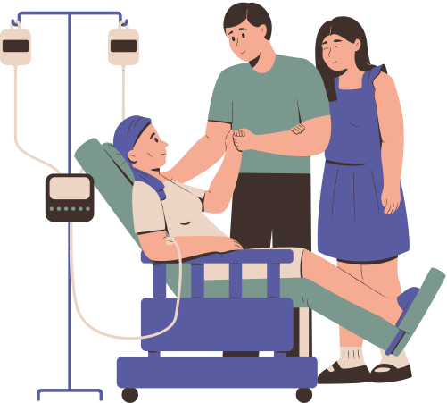
Problem Description
Monitoring Changes in the Condition of Home Hospitalization Patients Using Clinical Data and Free Text
In the context of home hospitalization, medical staff monitor the patient's condition through daily visits and regular reports.
Data is collected from various sources – physiological measurements, medical documentation,
and free-text descriptions from both patients and caregivers.
The challenge:
The information is dispersed, inconsistent, and often difficult to piece together into a clear clinical picture.
Changes in the patient’s condition - whether improvement or deterioration - can go unnoticed.
Key Problem:
How can we automatically detect day-to-day changes in a home-hospitalized patient's medical condition
by combining free-text input with structured clinical data?

Slide 3

Project Objectives
Effective home-patient monitoring demands accurate, timely clinical insights. This project aims to develop a clinical decision support tool for home hospitalization teams by:
Predicting changes in a patient’s condition between visits (improvement, no change, or deterioration).
Integrating heterogeneous data sources, including unstructured clinical notes and structured physiological measurements.
Demonstrating the effectiveness of a hybrid NLP+ML model in automating medical monitoring and detecting significant health trends.
Data Exploration
& Construction
Data Cleaning
& Preprocessing
Exploratory Data
Analysis (EDA)
Feature
Engineering
Modeling
Evaluation
Visualization
& Reporting
Conclusions
& Future Work
1
2
3
4
5
6
7
8

Slide 4

Task Specification
Input:
Free-text reports from home hospitalization on Day 1 and Day 2
Clinical measurements: heart rate, respiratory rate, blood pressure, temperature, oxygen saturation.
Output:
Classification of patient status: Deterioration, No Change, or Improvement
Performance Metrics:
Accuracy
F1-score
Plan:
1. Data Preparation & EDA
2. Text & Vitals Feature Engineering
3. Baseline Modeling (Text or Vitals only)
4. Combined Modeling (Text + Vitals)
5. BERT-based Models
6. Experimental Fusion Architectures
7. Final Evaluation & Model Selection

Slide 5
Project Plan
1. Data Preparation & EDA
Synthetic dataset generation simulating home-hospitalization cases
Manual labeling of condition change: Improvement / No Change / Deterioration
Initial class balance analysis
Split into Train / Validation / Test (80/20) with stratification
5. BERT-based Models
Manual fine-tuning on small dataset (BERT tokenizer + classifier head)
Classifiers: Logistic, XGBoost, Neural Net
Evaluate effect of pretrained embeddings vs. end-to-end finetuning
2. Text & Vitals Feature Engineering
Merge day1 and day2 notes → combined_text
Text cleaning: lowercasing, punctuation removal, spell correction, stopword removal
Vitals: compute Δ (day2 - day1) for HR, BP, Temp, etc.
Imputation (SimpleImputer) and Standardization (StandardScaler)
6. Experimental Fusion Architectures
Concatenation of BERT pooled embeddings + vitals as input
Neural MLP layers trained to classify 3 classes
Improved architectures showed inconsistent results (precision/recall variance)
7. Final Evaluation & Model Selection
Compare all models: Fusion, Classical, BERT-based
Visualize results using Accuracy, Macro-F1, and per-class Recall
Select best-performing model: LightGBM (TF-IDF + ΔVitals)
Present Recall comparison across classes (improvement / deterioration / no change)
3. Baseline Modeling (Text or Vitals only)
TF-IDF + Logistic Regression
Vitals only with XGBoost and Random Forest
Evaluate on validation/test splits using Accuracy & F1 (macro)
4. Combined Modeling (Text + Vitals)
Fusion pipelines combining TF-IDF or BERT embeddings + ΔVitals
Models: Logistic Regression, XGBoost, LightGBM, Neural Networks
Cross-validated performance: Accuracy, F1 per class

Slide 6

Prior Art
Source / Title (Year) | Approach / Model | Data (size) | Metrics | Results
“Deep learning for early warning of inpatient deterioration” (Nature Digit. Med., 2021) https://did.li/1otx5 | LSTM with attention on vital-sign time-series | 2,100 patient episodes (minute-by-minute vitals) | AUC, Macro-F1 | AUC 0.87, Macro-F1 0.71; attention maps showed SpO₂ drops and HR spikes as strongest early-warning signals; model predicts deterioration up to 12 h in advance.
“Fusion of clinical notes and vitals using BERT + MLP” (J. Gen. Intern. Med., 2023) https://did.li/fAVaa | BERT encoder on free-text notes + MLP head for vitals | 800 home-hospitalization episodes | Accuracy, Precision, Recall | Accuracy 0.76; Precision 0.74; Recall 0.72; text+vitals fusion improved Macro-F1 by 8 pp over vitals-only baseline; ablation confirmed synergy of both modalities.
“Combining vital signs and free-text for deterioration detection” (PMC, 2019) https://did.li/dR7CN | TF-IDF vectorization on clinical notes + LightGBM | 1,200 inpatient stays (notes + vitals) | ROC-AUC, Sensitivity, Specificity | ROC-AUC 0.79; Sensitivity 0.81; Specificity 0.75; top predictive text tokens included “pain,” “breathlessness,” “fatigue”; combining features outperformed single-modality.

Slide 7
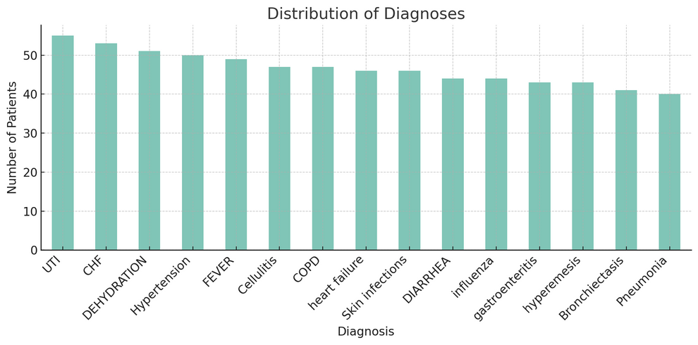
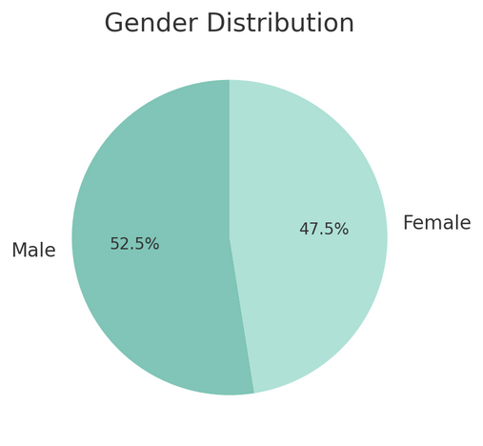
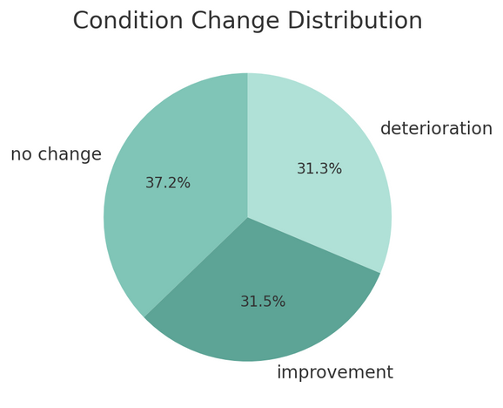
Data & Labeling
Synthetic Data and Clinical Status Labeling – Home Hospitalization
Data Generation
Patient Simulation:
The dataset was generated using gpt-4o prompting, simulating daily reports of home-hospitalized patients.
Key Fields:
day1_note and day2_note: first-person, simple, everyday-style text
Daily vitals: HR, BP, Temp, RR
Status change direction – aligned with both free text and vitals
reasoning: objective analysis of change between the two days
Randomized parameters:
Age (25-110), gender, medical diagnosis
Labeling & Classification
Classification Categories:
Improvement
Deterioration
No Change
Labeling Criteria:
Analysis of changes in vitals between Day 1 and Day 2
Language cues in the notes indicating improvement or deterioration

Slide 8

Data Preprocessing
Preprocessing of Text and Physiological Data
Free Text (Complaints Notes):
Merged day1_note and day2_note into a unified field: combined_text.
Applied multi-step text cleaning:
Lowercasing, punctuation and digit removal.
Spelling correction using SymSpell.
Removal of stopwords via NLTK.
Final result stored in cleaned_text.
NLP Techniques:
TF-IDF vectorization (up to 500 features, bigrams included).
Optional input to BERT tokenizer (bert-base-multilingual-cased) for deep models.
Final text representations used for classical models or combined with vitals.
Physiological Data:
Extracted vital signs from raw text (HR, RR, Temp, BP_SYS, BP_DIA) using regular expressions.
Computed day-to-day differences (*_diff columns).
Missing values imputed using SimpleImputer (mean strategy).
Standardized via StandardScaler before modeling.
Outcome:
Each patient is represented by a single feature vector, combining objective (vitals) and subjective (text) information.
Enables robust multi-class classification into health status change (target = no change / improvement / deterioration).

Slide 9
Modeling & Pipeline
Classify changes in patient condition based on clinical notes and vital sign deltas
Processing Pipeline:
Text data was combined with physiological measurements using a scikit-learn pipeline:
TF-IDF applied to combined_text
SimpleImputer and StandardScaler used for vitals (HR_diff, RR_diff, Temp_diff, BP_SYS_diff, BP_DIA_diff)
Spelling correction and stopword removal were applied to the text (for certain models)
Selected Models: | Selected Models:
Basic, easy to interpret, also used in the combined (fusion) model | Logistic Regression
Powerful model for tabular data; tested on vitals alone and on text+vitals | XGBoost
Fast alternative to XGBoost; also tested in the combined model | LightGBM
Text tokenized using bert-base-multilingual-cased for future integration | BERT (Tokenization)
TF-IDF on text + vitals → Logistic Regression | Fusion Pipeline
Key Notes:
Data was split into Train/Validation/Test sets using Stratified Split to preserve label distribution
5-fold Cross Validation was used for performance evaluation
A comparative analysis was conducted between raw text and cleaned/corrected text
Models were kept as simple as possible to ensure clinical interpretability

Slide 10
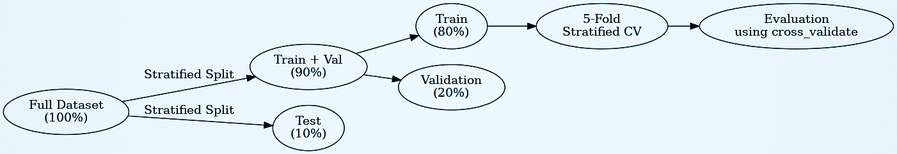
Evaluation Metrics & Performance
Key Metrics:
Accuracy:
The proportion of correct predictions out of all samples.
A basic and convenient metric for overall comparison.
Macro F1-Score:
The harmonic mean of Precision and Recall, calculated separately for each class and then averaged.
Particularly useful in cases of class imbalance.
Precision & Recall:
Precision: The percentage of correct predictions out of all instances predicted for a given class
Recall: The percentage of actual class instances correctly identified by the model
Evaluation Methodology:
An early split was performed into Train/Validation/Test sets: 90% Train+Val / 10% Test, using stratified split
Within the Train+Val set, an additional split of 80% Train / 20% Validation was applied
For some models, 5-fold Stratified Cross Validation was used
Metrics were computed using cross_validate from scikit-learn, without relying on classification_report

Slide 11


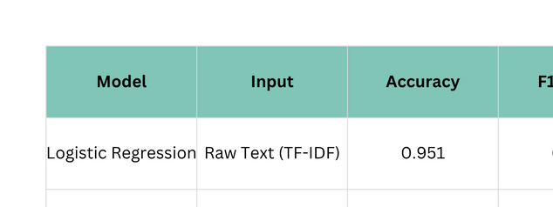
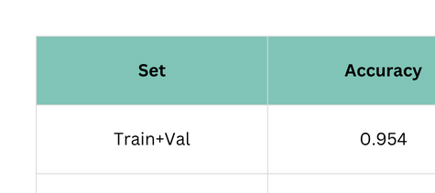
Intermediate & Baseline Results
Baseline Models (Train+Val, 5-fold CV):
Process:
Input:
Free-text from medical records
Text Processing:
TF-IDF Vectorization – Extracting features based on word frequency
Two Experiments:
Raw Text – No cleaning applied
Cleaned Text – Stopword removal and spelling correction
Conclusion: Even a simple text-only model performs well, but excessive text cleaning reduces performance.
Fusion Model – Text + Vitals Deltas:
Process:
Input:
Clinical Text → Processed using TF-IDF
Physiological Measurements → Calculated as delta values (change between consecutive readings)
Preprocessing:
Imputer to handle missing values
StandardScaler to normalize the vitals
Fusion:
A unified pipeline combining both text features and vital sign deltas
Model:
Logistic Regression – Classic and interpretable
Conclusion: Significant improvement over text-only models. Integrating vital sign deltas adds clear value.

Slide 12
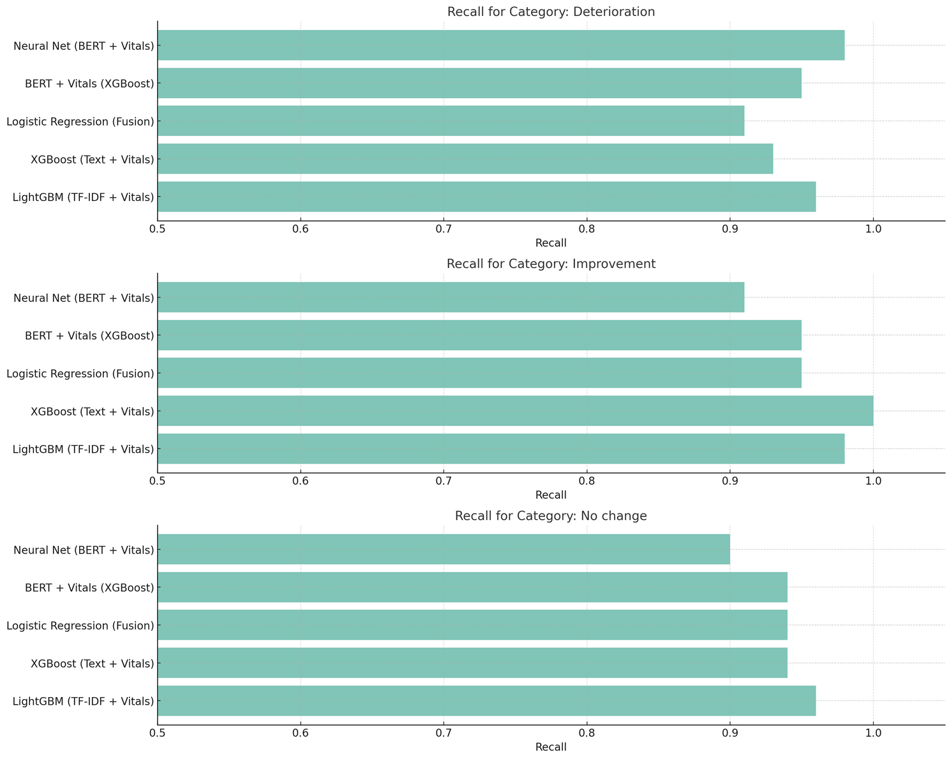
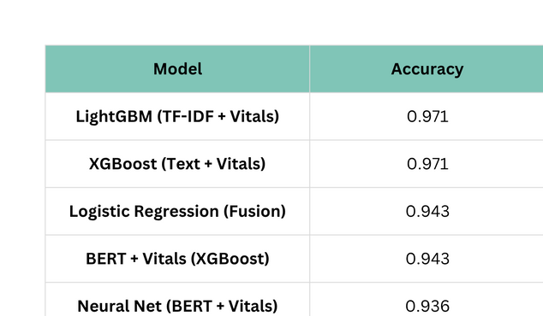
Main Results – Final Model Comparison
Model Comparison Insights
Combined models (Text + Vitals) achieved the highest performance, especially with XGBoost and LightGBM.
The Fusion Logistic Regression model delivered surprisingly strong results given its low complexity.
BERT-only models did not consistently outperform others, but performed well when integrated with quantitative data (Vitals).
Neural network models were less consistent — possibly due to sensitivity to hyperparameters or insufficient data.
Conclusion:
The best-performing models are those that combine natural language input with measured clinical data.
Choosing XGBoost or LightGBM with fused inputs offers the optimal balance between accuracy and interpretability.

Slide 13
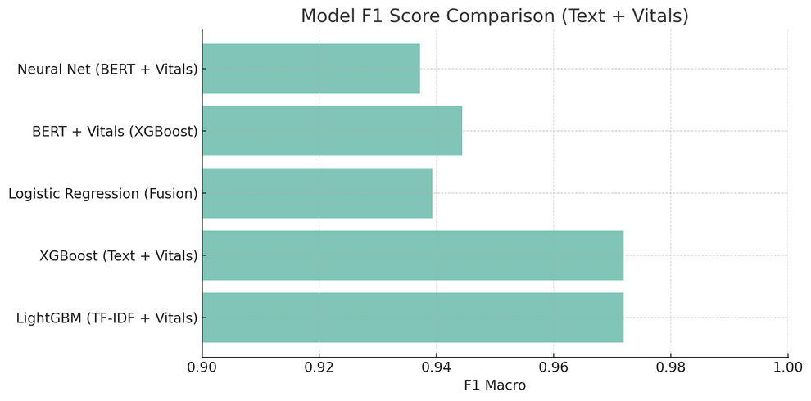
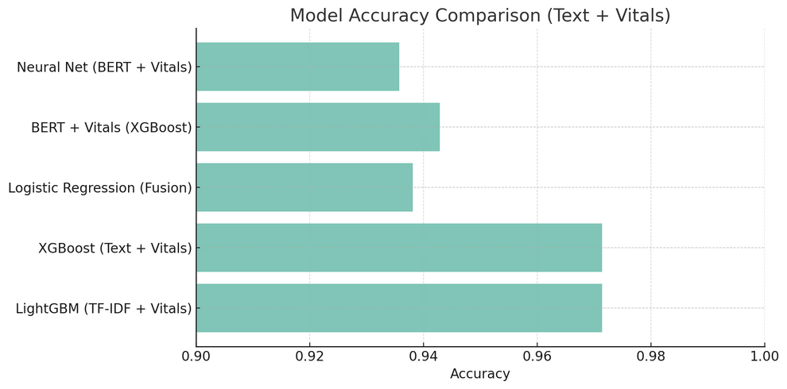
Insights & Final Takeaways
1. Simple models can go a long way
Logistic Regression with TF-IDF alone achieved high performance (F1 = 0.95) on raw clinical text.
Takeaway: Even simple solutions can yield strong results, especially when the input text is rich in clinical context.
2. Data fusion is key to success
All models that combined text with vital signs showed a clear performance boost.
This fusion leverages both the narrative context and the patient’s physiological state.
3. XGBoost and LightGBM stood out for both accuracy and consistency
These models reached over 97% accuracy when fed with combined inputs.
Their advantages include: robustness to missing data, feature importance analysis, and efficient learning.
4. BERT isn’t always better — it’s about how you use it
BERT alone performed lower (~81%), but when integrated with vitals, it achieved very strong results.
Conclusion: Smart integration matters more than the model’s complexity.
5. Deep models need optimization
Neural Networks showed potential but lacked consistency — likely due to data size limitations and sensitivity to hyperparameters.
Conclusion:
Accurate prediction of clinical change is achievable using accessible and interpretable models, as long as textual and clinical data are intelligently combined.

Slide 14
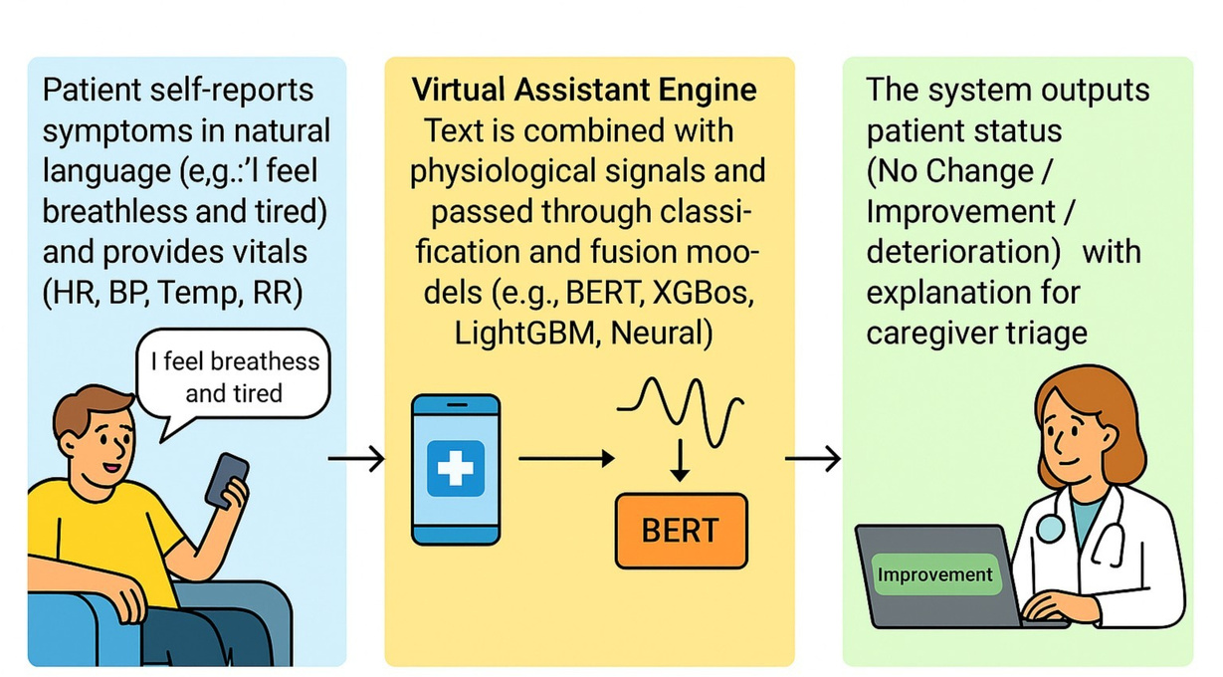
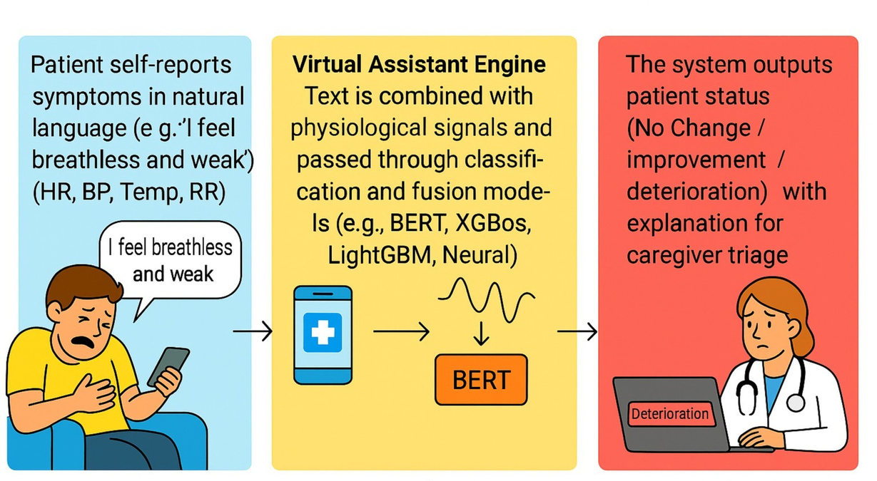
Graphical Abstract

Slide 15
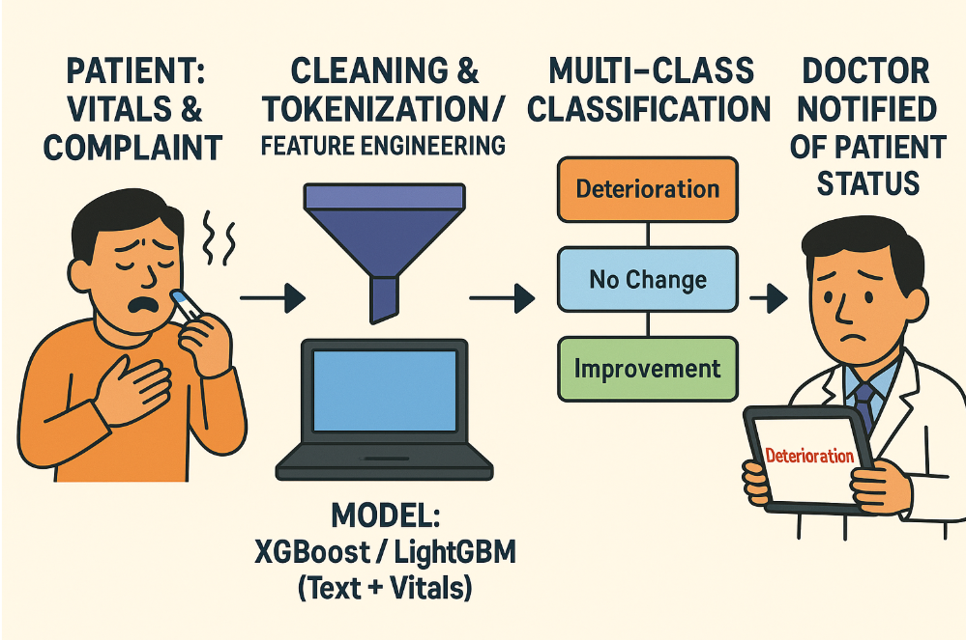
Graphical Abstract

Slide 16
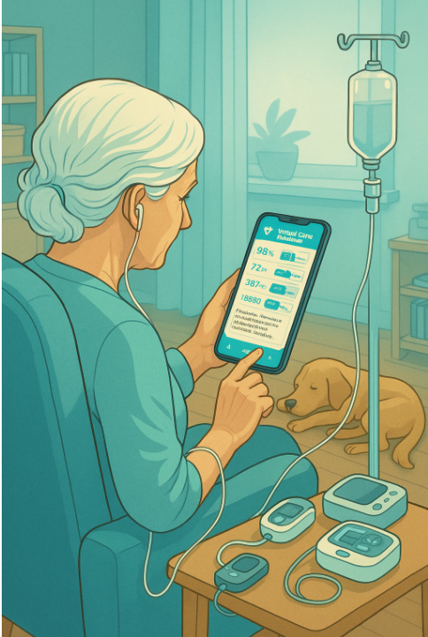
Thank You
for listening

